Slide 1
Linear Regression Model
Friday, 14 March 2025

Slide 2

Linear regression (1)
Dependent variable is a continuous data type
Distribution is normal (parametric)
Subject data is independent and identically distributed (i.i.d.)
Y-intercept
Error term
$$E\left[Y \right|X]=β_{0}+β_{1}X+ε$$
Expected value of Y given X
Change in Y associated with 1-unit change in X

Slide 3

Linear regression (2)
Y
Slope
Y-intercept
X
$$E\left[Y \right|X]=β_{0}+β_{1}X+ε$$

Slide 4

Linear regression (Glucose ~ Age)
Is Age associated with Glucose level?
Is a 1-unit change in Age significantly associated with Glucose level?
The null hypothesis is, there is no statistically significant association between Age and Glucose level
$$E\left[Y \right|X]=β_{0}+β_{1}X+ε$$
$$E\left[Glucose \right|Age]=Glucose= β_{0}+β_{1}(Age)+ε$$

Slide 5
Linear regression (Glucose ~ Age)
Is Age associated with Glucose level?
Does a 1-unit change in Age significantly associated with the Glucose level?
The null hypothesis is, there is no statistically significant association between Age and Glucose level
$$Glucose= β_{0}+β_{1}(19)+ε$$
$$Glucose= β_{0}+β_{1}(15)+ε$$
$${∆{Glucose}_{19−15}= β}_{1}\left(19−15\right)$$

Slide 6







Linear regression (Glucose ~ Age)
$$Glucose= β_{0}+β_{1}(19)+ε$$
$$Glucose= β_{0}+β_{1}(15)+ε$$
$$β_{0}=97.08$$
$$β_{1}=0.72$$
$${∆{Glucose}_{19−15}= β}_{1}\left(19−15\right)$$
Glucose level for 19-year old
Glucose level for 15-year old
$$Glucose=97.08+0.72(19)$$
$$Glucose=97.08+0.72(15)$$
$$110.76=97.08+0.72(19)$$
$$107.88=97.08+0.72(15)$$
$$110.78 −107.88=2.88$$
$${∆Glucose}_{19−15}=0.72∗4=2.88$$

Slide 7
Linear regression (Glucose ~ Pregnancy)
Is Pregnancy associated with Glucose level?
Is a 1-unit change in Pregnancy significantly associated with Glucose level?
The null hypothesis is, there is no statistically significant association between Pregnancy and Glucose level
$$E\left[Y \right|X]=β_{0}+β_{1}X+ε$$
$$E\left[Glucose \right|Pregnancy]=Glucose= β_{0}+β_{1}(Pregnancy)+ε$$

Slide 8




Linear regression (Glucose ~ Pregnancy)
Is Pregnancy [0,1] associated with Glucose level?
Does a 1-unit change in Pregnancy significantly associated with Glucose level?
The null hypothesis is, there is no statistically significant association between Glucose and Pregnancy
$$Glucose= β_{0}+β_{1}(1)+ε$$
$$Glucose= β_{0}+β_{1}(0)+ε$$
$${∆{Glucose}_{1−0}= β}_{1}(1−0)$$
$${∆{Glucose}_{1}= β}_{1}(1)$$

Slide 9








Linear regression (Glucose ~ Pregnancy)
$$Glucose= β_{0}+β_{1}(1)+ε$$
$$Glucose= β_{0}+β_{1}(0)+ε$$
$$β_{0}=123.00$$
$$β_{1}=−2.46$$
$${∆{Glucose}_{1}= β}_{1}\left(1\right)$$
Glucose level for subjects with pregnancy
Glucose level for subjects without pregnancy
$$Glucose=123.00−2.46(1)$$
$$Glucose=123.00−2.46(0)$$
$$120.54=123.00−2.46(1)$$
$$123.00=123.00$$
$120.54 −123.00=$-2.46
$${∆Glucose}_{1}=−2.46$$

Slide 10
Linear regression (Glucose ~ Pregnancy + Age)
Is Pregnancy associated with Glucose level controlling for Age?
Is a 1-unit change in Pregnancy significantly associated with Glucose level controlling for Age?
The null hypothesis is, there is no statistically significant association between Pregnancy and Glucose level controlling for Age
$$E\left[Y \right|X]=β_{0}+β_{1}X_{1}+β_{2}X_{2}+ε$$
$$Glucose= β_{0}+β_{1}\left(Pregnancy\right)+β_{2}\left(Age\right)+ε$$

Slide 11
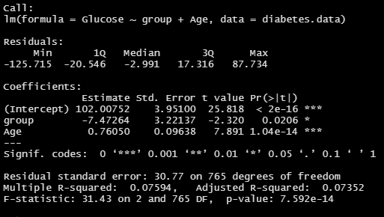


Linear regression (Glucose ~ Pregnancy + Age)
$$β_{0}=102.01$$
$$β_{1}=−7.47$$
$$β_{2}=0.76$$

Slide 12
Linear regression (Glucose ~ Pregnancy + Age)
According to the linear regression model, Subjects who experienced pregnancy had, on average, a 7.47-point reduction in glucose levels (95% CI: -13.80, -1.15) compared to subject without pregnancy controlling for age.

Slide 13
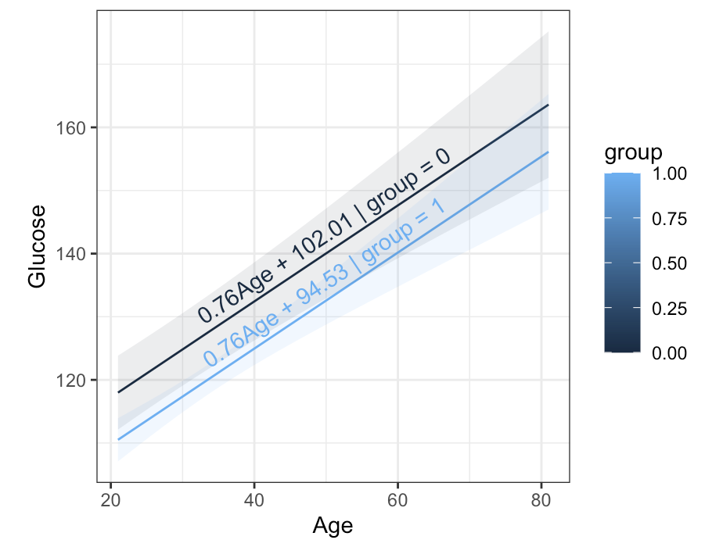
Linear regression (Glucose ~ Pregnancy + Age)
$$Glucose= β_{0}+β_{1}\left(Pregnancy\right)+β_{2}\left(Age\right)+ε$$
$$Glucose=102.01+(−7.47)\left(1\right)+(0.76)\left(20\right)+ε$$
$$Glucose=102.01+(−7.47)\left(0\right)+(0.76)\left(20\right)+ε$$

Slide 14
Questions

